Slide 1
ISO Public Protection Classification (PPC)
Notes:
[click for next slide]

Slide 2



Fire Suppression Rating Schedule (FSRS)
A community evaluation, not just a fire department evaluation
The FSRS is a first alarm schedule
105.5 points possible
References proven national standards
An objective review of available public fire protection

Slide 3
FSRS Classes 1 to 10
90.00 to 100 + Points = Class 1
80.00 to 89.99 Points = Class 2
70.00 to 79.99 Points = Class 3
60.00 to 69.99 Points = Class 4
50.00 to 59.99 Points = Class 5
40.00 to 49.99 Points = Class 6
30.00 to 39.99 Points = Class 7
20.00 to 29.99 Points = Class 8
Meets 8B requirements = Class 8B
10.00 to 19.99 Points = Class 9
00.00 to 9.99 Points = Class 10 (or 10W)

Slide 4
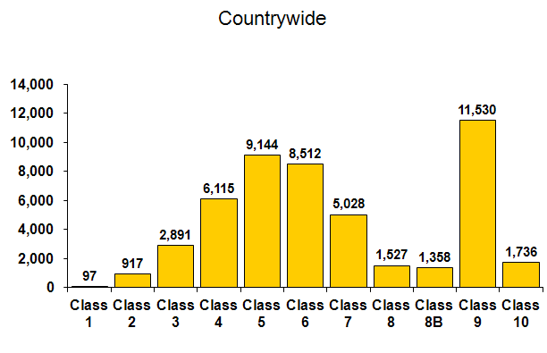
PPC Distribution

Slide 5
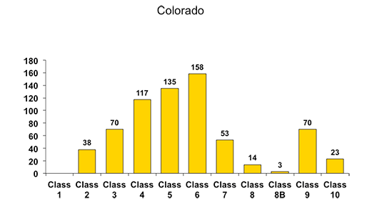
PPC Distribution

Slide 6
FSRS Minimum Requirements
Organization: must be organized / boundaries
Membership: at least 4 responders
Training: 12 hours per member per year
Alarm notification: no delay (60 seconds max)
Apparatus: NFPA 1901
Housing: apparatus protected from the weather and station heated where needed

Slide 7
Agencies Reviewed = 105.5 points
Fire Alarm 10%
Fire Department 50%
+ Community Risk Reduction 5.5%
Water Supply 40%

Slide 8
Emergency Communications
Credit for Emergency Communications - 10 points
  Credit for Emergency Reporting - 3 points
  Credit for Telecommunicators - 4 points
  Credit for Dispatch Circuits - 3 points

Slide 9
Emergency Communications
Emergency Reporting System
  No 9-1-1 or Basic 9-1-1
  Enhanced 9-1-1
  ANI - Automatic Number Identification
  ALI - Automatic Location Identification

Slide 10
Telecommunicators
Telecommunicator performance based on:
  Call receipt
    Answer 95% of alarms within 15 seconds and 99% of alarms within 40 seconds
  Call processing
    Complete 80% of emergency dispatching within 60 seconds and 95% within 106 seconds
  Call transfer
    Transfer 95% of all alarms from a PSAP within 30 seconds, if applicable

Slide 11
Telecommunicators
Emergency Dispatch Protocols for Fire Service (EDP):
  Telecommunicators have EDP containing questions and use those protocols to provide pre-arrival instructions to emergency responders and callers

Slide 12
Telecommunicators
Initial Training, Certification, Con-Ed, Quality Assurance
  Telecommunicators are certified in the knowledge, skills, and abilities corresponding to their job functions
  Telecommunicators participate in continuing education and/or in-service training
  Quality-assurance programs as appropriate for their positions

Slide 13
Dispatch Circuits
Review of the dispatch circuit
  Type of dispatch circuits provided
  Monitoring for integrity
  Emergency power supply and Testing

Slide 14
Fire Department
Credit for Fire Department - 50 points
Fire Engines – 6 points
Reserve Engines – 0.5 points
Pump Capacity – 3 points
Ladder Service – 4 points
Reserve Ladder Service – 0.5 points
Deployment Analysis– 10 points
Company Personnel – 15 points
Training – 9 points
Operational Considerations - 2 points

Slide 15
Determining Needed Fire Flow for Commercial Properties
Effective area
Construction Factor
Occupancy Factor
Exposure Factor
Needed Fire Flow Reports
Sprinklered - NFF = 0 gpm

Slide 16
Determining NFF- Residential Areas
Residential Needed Fire Flow based on average distance between dwellings
    0 - 10 feet - 1500 gpm
    11 - 20 feet - 1000 gpm
    21 - 30 feet - 750 gpm
    30+ feet - 500 gpm

Slide 17
Determining NFF- Residential Areas
Needed Fire Flow of 1 and 2 family dwellings with effective area greater than 4,800 square feet
    Use the Needed Fire Flow formula
    Duration as specified in Section 604

Slide 18
Individual Property
Applies to specifically rated properties having a Needed Fire Flow greater than 3,500 gpm
Not included with the grading of the Community
PPC may be different from the graded community

Slide 19
Primary / Automatic Aid / Mutual Aid
Primary Department
  Responsible for fire protection
Automatic Aid Department
  Responds on 1st alarm with the Primary Department
  May be creditable
Mutual Aid Department
  Does not respond on 1st alarm
  Usually not creditable in the grading

Slide 20
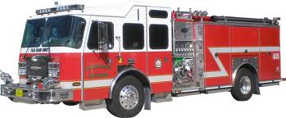
Engine Companies
Engine Companies
  Maximum credit 6 points
  Minimum pump capacity: At least 1 engine with a 750 gpm pump in department (or Automatic Aid)
Credit can apply for Automatic Aid Engines, and shared stations

Slide 21
Engine Company Equipment
Equipment on Existing Engine Companies
  Equipment based on NFPA 1901 requirements
  No separate ISO equipment list
  Automatic Aid engines can receive 100% credit

Slide 22
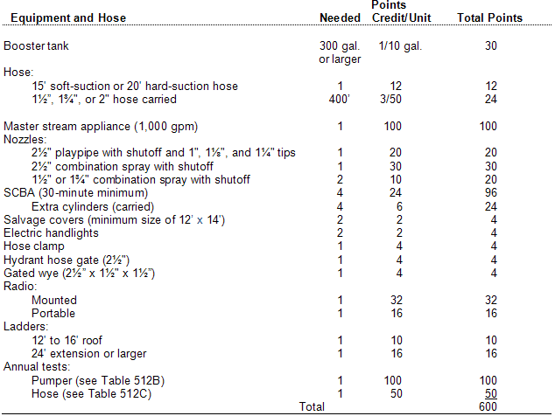
Engine Company Equipment

Slide 23
Reserve Engines
  Maximum credit 0.5 points
  1 reserve engine needed for each 8 needed engine companies
  Can be shared between departments at full credit

Slide 24
Pump Capacity
Pump Capacity
Maximum credit 3.0 points
Should equal or exceed Basic Fire Flow (BFF)
    BFF = 5th highest Needed Fire Flow
Pump capacity limited to
  75% if partial test records
  50% if no test records

Slide 25
Pump and Hose Testing
Pump testing credit based on average of the past 3 test intervals
Hose testing credit based on average of the past 3 test intervals
Based on manufacture’s recommendations
75% credit for partial records
No records, no credit

Slide 26
Ladder / Service Companies
Equipment on Existing L/S Companies
  Equipment based on NFPA 1901 requirements
  No separate ISO equipment list
  Automatic Aid engines can receive 100% credit to both communities

Slide 27
When Do I Need a Ladder Truck?
5 buildings 3 or more stories
(2 ½ stories homes do not count)
5 buildings with NFF over 3,500 gpm
5 buildings single story - 32’ tall
            OR
Combination of 5 of the above
A service truck is needed if a ladder truck is not needed

Slide 28
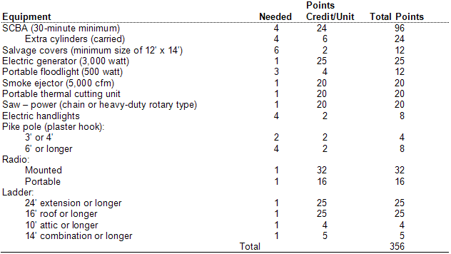
Service Company Equipment

Slide 29
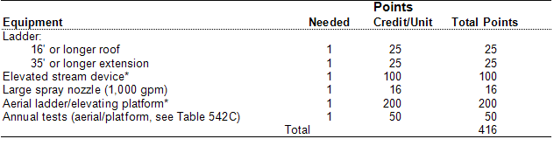
Ladder Company Equipment

Slide 30
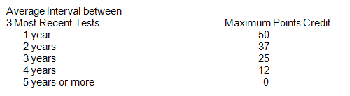
Testing of Aerial Devices
Aerial testing credit based on average of the past 3 years intervals
Non Destructive Test (NDT) required every 5 years. If no NDT with in the past 5 years, no credit for aerial/platform device.

Slide 31
Equipment- Engine, Ladder, Service
Areas of biggest change
  Promotion of shared resources
  Standardized to meet NPFA requirements and remove outdated equipment
  Shift from high possible equipment credit to focus on deployment and location of stations and resources

Slide 32
Deployment Analysis
Deployment Analysis
  Maximum credit 10 points
  Optional Deployment Analysis per NFPA 1710 (Standards of Coverage)
  Road mile analysis (1½ mile and 2½ mile) used when the standards of cover is not available

Slide 33
Company Personnel
Existing Company Personnel
  On-Duty / PSO / On-Call
  Credit for Automatic Aid Personnel
    With or without needed apparatus
    Up to 100% credit
  Firefighters must have protective clothing ensemble available

Slide 34
Company Personnel
Types of Fire Departments
  On Duty/Career Departments
  On Call/Volunteer Departments
  Combination Departments
  Public Safety Officers
  Subscription Departments
    May not be eligible for classification
    Must have a geopolitical boundary
    Must respond to all calls in their response area
    Must meet FSRS minimum requirements

Slide 35
Company Personnel
On Duty Staffing = Hours worked
Career staff at fire stations
Special units
  Fire inspectors
  Mechanics
  Haz Mat, Training staff
Volunteer staffing at stations
  Sleep-in crew, Duty crews
  Roster / documentation required
Firefighters on EMS units with gear

Slide 36
Company Personnel
On Call Staffing
  Average response of volunteer members not located at stations, responding from homes, businesses, etc.
  Not including false alarms, recalls, automatic alarms

Slide 37
Company Personnel
Not Creditable
  EMS only personnel
  EMS / Fire personnel only performing EMS duties
  Staff that do not perform firefighting operations
    Fuel truck driver
    Mechanic
    Arson investigator
    Rehab organizations
    Wildfire crews
  Fire Police
  Live in college students (non Firefighter certified)
  Junior Firefighters

Slide 38
Training
Maximum Credit is 9 points
  Sub-items total 100 points
  Records required for credit
  Based on responding personnel, not legacy members
  Facilities can be any distance from community
  Facilities can be shared between communities, counties and states

Slide 39
Training
Minimum Training Requirements
Active personnel:
  3 hours of structural firefighting related training every 3 months for a minimum of 12 hours per year

Slide 40
Training
Training Facilities and Use must be at a training facility (local, county, state)
    Training area at least 2 acres in size (full credit)
    Full credit given for 18 hours per member per year
    Reference NFPA 1402
    Worth 35 sub-points / 100 points
    Accounts for 3.15 total points

Slide 41
Training- Facilities
    Drill tower at least 3 stories in height
    Live fire training structure including smoke room

Slide 42
Training
  Company Training Program includes use of local buildings, streets and open areas
    Full credit given for 16 hours per member per month
    Reference NFPA 1001
    2.25 Total Points

Slide 43
Training
Officer Training Program
  Officer certification
  Continuing education
  Reference NFPA 1021 and NFPA 1561
  1.08 Total Points

Slide 44
Training
New Driver / Operator Training Program
  60 hours
  Reference NFPA 1002 and NFPA 1451
Existing Driver / Operator Training Program
  12 hours annually
  0.45 Total Points Each

Slide 45
Training
Hazardous Materials Training Program
  6 hours annually
  Reference NFPA 472
  0.09 Total Points
Recruit Training
  240 hours in the first 12 months
  Reference NFPA 1001
  Structural fire training
  0.45 Total Points

Slide 46
Training
Building Familiarization for Pre-Incident Planning
    Annual inspections / tours
    Used in training program
    Reference NFPA 1620
    1.08 Total Points

Slide 47
Operational Considerations
Standard Operating Procedures (SOP)
Evaluates established SOP’s for FD emergency operations
Apparatus response / operation / inspection / maintenance
Safety at incidents
Training
Company operations
1 Point

Slide 48
Operational Considerations
Incident management system
Use an established Incident Management System
NIMS
NFPA 1561
1 Point

Slide 49
Community Risk Reduction - 5.5 points
Fire prevention Code Adoption and Enforcement - 2.2 points
  Public Fire Safety Education - 2.2 points
  Fire Investigation - 1.1 points
  Total – 5.5 Points

Slide 50
Community Risk Reduction
Fire Prevention Code Adoption and Enforcement
Code adoption and regulations
Fire Prevention Staffing
Training / Certification
Fire Prevention Programs
  Continuing education
  Plan review
  Pre-fire planning

Slide 51
Community Risk Reduction
Public Fire Safety Education
Educator qualifications / training
  Continuing education
Fire safety programs
  Juvenile fire setter intervention programs
  Program for occupancies having large loss potential

Slide 52
Community Risk Reduction
  Fire Investigation
  Fire investigation Organization and Staffing
  Fire investigator Certification and Training
    Fire investigator Continuing Education
  Use of the National Fire Incident Reporting System

Slide 53
Water Supply - 40 points
Adequacy of water supply – 30 points
  Hydrant, size, type & installation – 3 points
  Inspection and fire flow testing of hydrants – 7 points

Slide 54
Adequacy of Water Supply
The ability of the water distribution system to deliver the Needed Fire Flow at selected test locations
Minimum acceptable flow – 250 gpm for 2 hours + consumption
Minimum storage – 30,000 gallons + consumption

Slide 55
Hydrants - Inspection & Flow Test Program
Hydrant Inspection
  Annual inspection program
  In accordance with AWWA Manual 17
  Flushing program
  Pressure testing
Inspection program for cisterns and suction points

Slide 56
Hydrants - Inspection & Flow Test Program
Fire-Flow Testing
  All parts of the water system need to be flow tested
  Maximum credit if tested every 5 years,
  10 years or more - no credit
  Hydrant marking system
    NFPA 291 or AWWA Manual M17
    **Bonus credit**
  Records
    Partial - 75% credit
    None - 0% credit

Slide 57
Hydrants - Inspection & Flow Test Program
Computerized Hydraulic Model
  Properly installed
  Calibrated annually
  Produces static pressure and flow predictions at 20 psi residual
  Model verified by actual flow tests
  AWWA Manual M32
Hydrant Marking System

Slide 58
Alternative Water Supply
Fire Department supplied water
  Tender response
  Large diameter hose relay
Certified water supply points
  Suction Points
  Dry Hydrants
  Cisterns
Notes:
Credit may be given for suction points with demonstrated capability of supplying 250 gpm for at least 2 hours
Hydrant distribution credit is the total of all hydrants within 1000 feet of the flow test location.
Hydrant distribution credit can be extended by use of large diameter hose.

Slide 59
Alternative Water Supply
The only criteria is the delivery of 250 gpm within 5 minutes of the arrival of the first apparatus AND the continual delivery of at least 250 gpm for the needed duration
Applies to distances over 1,000 feet from a recognized water source
Supply may be: Hydrants / Suction Points / Dry Hydrants

Slide 60
PPC changes in 2014
Revised and New PPC classifications
  Change in split classes for Class 8B and 9
  New 10W Class
  Reflects more favorable loss experience than Pure Class 8B, 9 and 10
Filing effective July 1, 2014

Slide 61
PPC changes in 2014

Slide 62
New Water Class- 10W
Class 10W is property-specific. Not all properties in the 5-to-7-mile area around the responding fire station will qualify. The difference between Class 10 and 10W is that the 10W-graded risk or property is within 1,000 feet of a creditable water supply.
Creditable water supplies include fire protection systems using hauled water in any of the split classification areas.

Slide 63
What does it mean?
Savings for homeowner’s and commercial property owners in 1x-8x; 1y-8y and 10W areas
The revised classifications changed automatically effective July 1, 2014

Slide 64
The Grading Process
ISO Grading is triggered
  Cycle (4 year grading schedule); Request; Inquiry
Pre-Survey Meeting (1-2 hours)
  Discuss requirements, prior grading, changes in community/department; answer all questions
Survey Meeting (2-3 hours)
  ISO evaluates community as discussed in pre-survey
Grading processing (1-3 months)
  Includes mapping and geo-coding stations, hydrants
Results and report sent to community officials
  Contact ISO with any questions going forward

Slide 65
The Grading Process
Special Circumstances
  Retrogressions- In person meeting with ISO manager and minimum 12 months of assistance
  New stations, hydrants, boundary changes- Contact ISO, changes can be made without survey
  Assistance with change scenarios

Slide 66
ISO Community Mitigation Contacts
Stephanie Garemore Ruscansky, Manager
  (503) 915-4604
  sruscansky@iso.com

